Slide 1

Introduction to the College Application Process

Slide 2

What To Expect
You will use your Naviance Student account to add your colleges you are applying to, request transcripts, and request your teacher letters of recommendations!
Log in using the Naviance icon on your desktop. If prompted, enter your school credentials
Notes:
What other things do you need from students:
Brag Sheet Counselors/Teachers
Anything from parents?
Test Scores
NCAA

Slide 3

What To Expect
Accurately tracking your college applications in Naviance Student will allow the counseling office to send transcripts and your teachers to send letters of recommendation on your behalf.
You will also be able to check the status of materials being sent right in your Naviance Student account, which saves you time and stress!
Notes:
What other things do you need from students:
Brag Sheet Counselors/Teachers
Anything from parents?
Test Scores
NCAA

Slide 4

First Steps
Decide which colleges you will be applying to:
Do additional research in Naviance Student to narrow down your college application list.
If you are not sure if you will apply to a particular college, add that college to the Colleges I’m Thinking About list until you are sure.
Review application requirements and begin working on your essay. Common App essay prompts can be found on their website

Slide 5
Common App Schools in Indiana
Anderson University
Butler University
DePauw University
Earlham College
Franklin College
Goshen College
Hanover College
Holy Cross College
Indiana University – Bloomington
IUPUI
Manchester University
Purdue University
Purdue University – Fort Wayne
Rose Hulman Institute of Technology
Saint Mary’s College of Indiana
Saint-Mary-of-the-Woods College
Trine University
University of Evansville
University of Indianapolis
University of Notre Dame
University of Saint Francis
Valparaiso University
Wabash College

Slide 6

First Step if Applying to a Common App College
Match Common App & Naviance Student accounts
Go to www.commonapp.org after August 1 to create your account or log into your existing account by clicking Apply Now
Complete the Education section and enter in your school’s name or CEEB code (Common App tab > Education)
Add at least one college to your My Colleges list
Complete your FERPA Release Authorization
Log into your Naviance Student account and navigate to the Colleges tab > Colleges I’m Applying To
On the Common App matching screen, enter the same email address you used to register on Common App and click Match.
http://www.screencast.com/t/gxEQkElyo1
Notes:
What other things do you need from students:
Brag Sheet Counselors/Teachers
Anything from parents?
Test Scores
NCAA

Slide 7
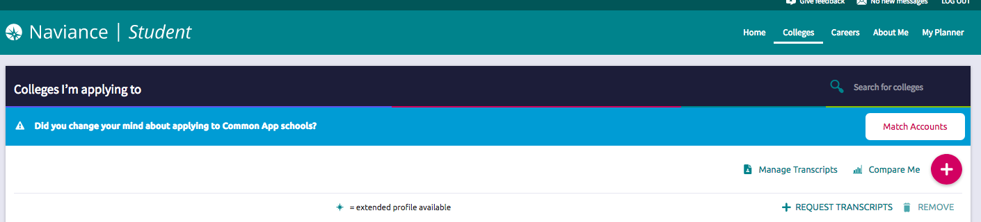
Next Steps
Adding colleges to your Colleges I’m Applying To list in Naviance Student is easy.
For any Common App colleges, those will sync automatically once you match your Naviance Student and Common App accounts.
For any non-Common App colleges, you will add those directly in Naviance Student (Colleges tab > Colleges I’m Applying To > Click the + pink button)
Notes:
What other things do you need from students:
Brag Sheet Counselors/Teachers
Anything from parents?
Test Scores
NCAA

Slide 8
What To Expect
Make sure you indicate how you are applying to the particular college.
Some colleges accept applications through Common App or another method. You will need to update how you are applying in Naviance Student so the counseling office knows how to send the materials.
Notes:
What other things do you need from students:
Brag Sheet Counselors/Teachers
Anything from parents?
Test Scores
NCAA

Slide 9
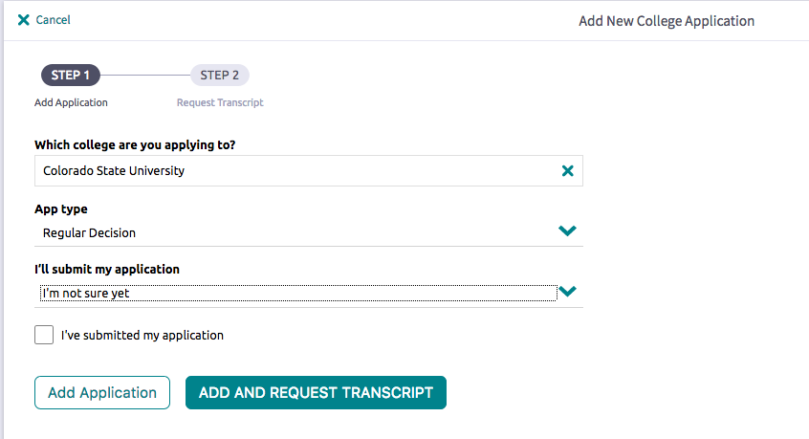
What To Expect
Notes:
What other things do you need from students:
Brag Sheet Counselors/Teachers
Anything from parents?
Test Scores
NCAA

Slide 10
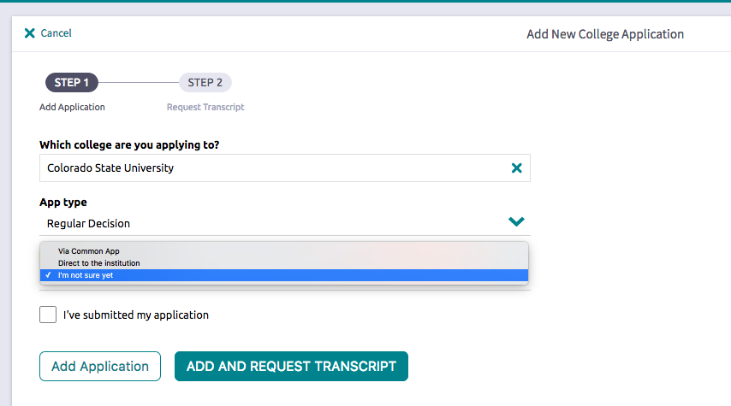
What To Expect
If you are NOT applying to the college via Common App, select the “directly to the institution”
option.
Notes:
What other things do you need from students:
Brag Sheet Counselors/Teachers
Anything from parents?
Test Scores
NCAA

Slide 11
Next Steps
You will request transcripts from the Colleges tab when you add colleges to the Colleges I’m Applying To list is up to date.
Once you know which colleges you are applying to, add those colleges into Common App or Naviance Student directly (for non-Common App colleges) to your Colleges I’m Applying To list. You are required to keep the list up to date!
Notes:
What other things do you need from students:
Brag Sheet Counselors/Teachers
Anything from parents?
Test Scores
NCAA

Slide 12

Next Steps
Think about which teachers you would like to write you letters of recommendation:
You can request a teacher write a letter of recommendation for all colleges, or for an individual college. Please ask teacher in person first.
Make sure you give your teachers plenty of time (at least 2 weeks) to write and submit your letter before the deadline and make sure you write your teacher a thank you note!
Give them a copy of your academic resume
Any outside recommenders (not school staff) should be requested directly from your Common App account for Common App colleges.

Slide 13
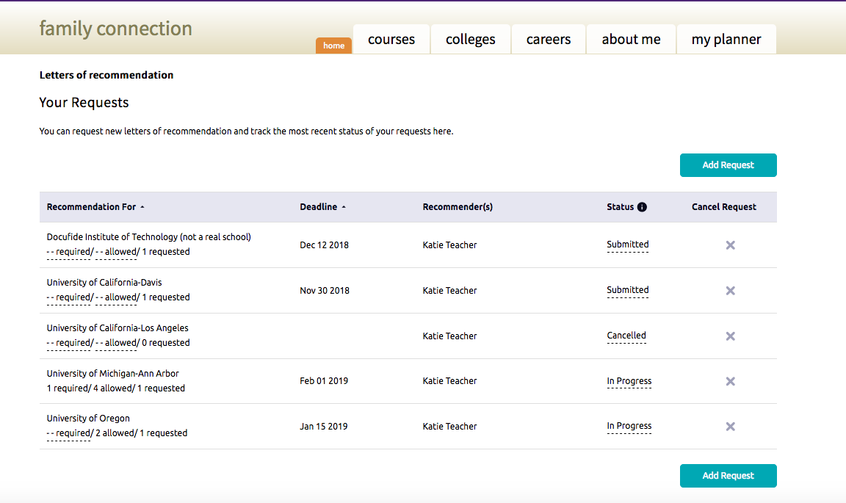
Next Steps
You will request your teacher letters of recommendation directly from Naviance Student for all college applications (Common App and non-Common App).
Navigate to the Colleges tab > Letters of Recommendation > Add Request.
You will submit a separate request for each teacher you would like to write you a letter of recommendation.
Notes:
What other things do you need from students:
Brag Sheet Counselors/Teachers
Anything from parents?
Test Scores
NCAA

Slide 14
SCHEDULE CHANGES
The transcripts we send to colleges have your senior year schedule on it. Colleges make admissions decisions partly based on this information. If you request a schedule change after we have sent transcripts, you must contact the university to inform them of this change
  If you are dropping an elective, it might not be an issue – unless it is related to your major
  Dropping a core content course probably WILL be an issue
    Core Content = English, Math, Science, Social Studies
    BIG Issue = Dropping an AP or Dual Credit course

Slide 15

Final Steps
At the end of the school year, take the Graduation Survey in Naviance Student. We wish you much success!
Notes:
What other things do you need from students:
Brag Sheet Counselors/Teachers
Anything from parents?
Test Scores
NCAA

Slide 16
Other Announcements
If you are playing sports in college, you need to register with NCAA or NAIA
If you are planning on graduating early, stop by the counseling office for an early grad application
Check your email DAILY
Senior Appointments with your Counselor will start Monday
  Introducing Mr. Treesh (A-L)
  Spreadsheet with 2 tabs
  If you realize you have a conflict, see Mrs. Birr or email her (dabirr@wanee.org) to reschedule
Flyer of all available test dates will be emailed to you
  ACT sign up is now until Friday
  If you are college bound, I recommend both tests (ACT/SAT)

